Slide 1
Security considerations for SOA
Securing access to information is fundamental for any business.
Security more critical for implementations based on SOA principles, due to the loose coupling and their operation across organizational boundaries.
Such an environment often exposes the brittleness and limitations of existing security implementations.
A new reference model to address these capabilities.
A secure business needs a flexible, customizable infrastructure, so it can adapt to new requirements and regulations.
Merely securing the perimeter with firewalls or routers is not sufficient.
As business needs to have dynamic trust relationships over time with its partners, customers, and employees.
To provide such flexibility, a business needs to leverage a security services infrastructure.

Slide 2
Security considerations in a service-oriented environment
The need for identity to be decoupled from the services. All entities in SOA have identities - users, services, and so on, that need to be properly identified so that appropriate security controls can be applied.
The need to seamlessly connect to other organizations on a real-time, transactional basis
The need to ensure that, for composite applications, proper security controls are enacted for each service and when services are used in combination
The need to manage identity and security across a range of systems and services that are implemented in a diverse mix of new and old technologies
Protection of business data in transit and at rest
The need for demonstrable compliance with a growing set of corporate, industry, and regulatory standards

Slide 3
User and service identities and their propagation
An SOA aims to provide services that can be interconnected and reused.
These services must be connected and implemented in a secure and auditable manner, according to a defined security policy.
Identity therefore plays a key role in delivering on the promise of service orientation.
The identities might need to be propagated throughout the SOA environment. In many cases, service implementations can restrict the options and formats available for propagating a user’s identity to/from the service.
Identity Services are therefore required in the infrastructure to deal with these identity mediation issues, so that services can be easily interconnected without worrying about how to map and propagate user identity from one service to the next.
This approach can greatly reduce the amount of code written and hence improve the speed and ease of developing new services

Slide 4
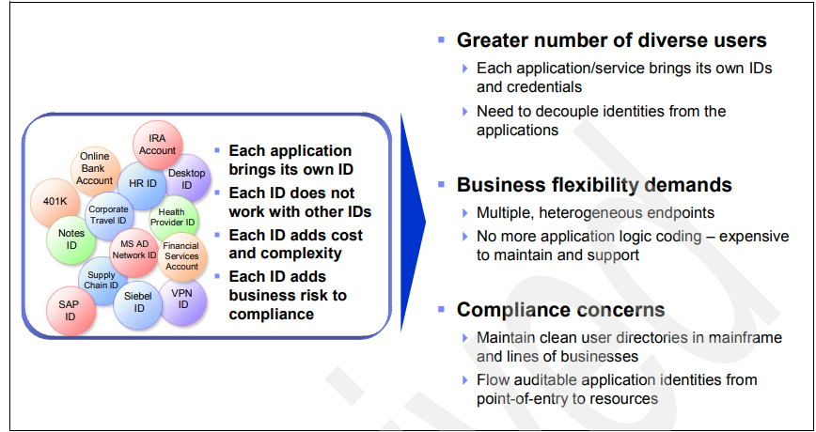
Identity challenges in SOA

Slide 5
Connect to other organizations on a real-time, transactional basis
There are several forms of inter-organization interaction that can occur in a service-oriented deployment.
Security, identity, and access policies are defined and enforced for all transactions. These policies need to be enforced for both incoming and outgoing requests.
Boundary security services are an obvious starting point. These boundary security services must be able to provide coarsely grained verification that requests are coming from or going to trusted parties.
Establishing the trust relationship between the organizations is a key step in allowing inter-organization cooperation. This involves establishing rules around interaction, such as defining identity information that must be propagated between organizations, as well as establishing the cryptographic keys used for securing the messages
It is very unlikely that user identities will be the same in all of the service components in a business process flow that spans different organizations.
Identity Services will therefore be required to validate the identity of the requesting user, confirm that they are authorized to perform the requested operation, and map their identity to one that the target service can understand and use to identify the user or service making the request.

Slide 6
Composite applications
The security policy for the services includes the rules established for allowing services to be accessed. A user or service might require specific privileges to allow them to access a service.
When services are combined, such as when they are choreographed into a higher level business process, the combination of these services might require another examination of the security policy. For example, a user might be allowed to access Service A and Service B independently. However, when these two services are choreographed together, perhaps with other service invocations, then the user is no longer allowed to access these services.
The complexity in an SOA environment is that the security policy for the choreographed services needs to take into account the mixing and matching of services in different combinations as required to reflect changes in business processes.
Each new choreography might require examination of the security policy to ensure it remains valid for this new combination

Slide 7
Managing security across diverse environments
A typical SOA will have many points at which security policy is enforced and implemented. These policy enforcement points will be located both at the service connectivity level, as well as within the implementations of the services themselves.
Management of a policy across these various heterogeneous enforcement points requires an administrator to use a diverse set of resource centric management interfaces, and their associated security policy terminology and semantics.
For SOA to achieve its goal of business flexibility within an environment of governance and regulatory compliance, definition and management of security policy need to be simplified.
There must be consistent management terminology and semantics across the various enforcement points. This defined policy can then either be directly enforced by the enforcement points or automatically translated into something that the endpoints can understand and enforce.

Slide 8
Protecting data
Protection of data from unauthorized modification and disclosure is a key requirement within SOA.
A policy must therefore be in place to ensure that data is protected in both transit and at rest, with consistent security measures applied.
Data protection is especially important when data moves outside the organizational boundary, which can happen without the knowledge of the consumer.
For example, an internal service might be replaced with an outsourced service, with data now flowing to the external organization. If the data is business or privacy sensitive, then the service provider might need to ensure appropriate protection is in place to satisfy the policy requirements of the calling organization.

Slide 9
Compliance with a growing set of regulations
Auditing of transactions is required to provide the data needed for assessing compliance, which measures the performance of the IT environment relative to measures established by the business policies.
This might include verifying the working system against a set of internally created policies and also against external regulatory acts. Complexity is increased in SOA where different applications from different sources or vendors are targeted for different levels of compliance.
This is especially true when accessing services provided by an external organization, where the regulatory and compliance regime is different from the requesting organization.
If possible, the audit data produced by the various policy enforcement points must be integrated into a single repository, or federated into a single logical view of the data. This will facilitate the production of the required audit reports, verification of compliance against policy, and investigation of security-related events

Slide 10
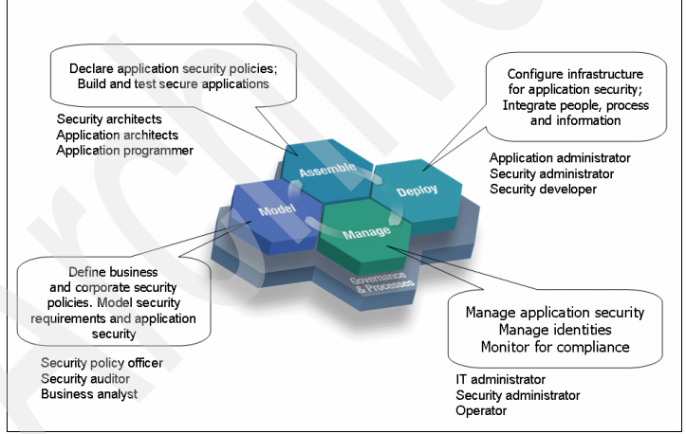
Service-oriented life cycle from a security perspective

Slide 11
Summary
The overall security principles that apply in any environment, whether SOA or not, are the same: identity, authentication, authorization, confidentiality, integrity, audit and compliance, policy management, and availability.
What changes in SOA is how they are applied.
Security management considers all aspects of the service-oriented life cycle and is a key enabler for achieving the connectivity and flexibility goals of service orientation.
Examination of high level requirements for security management in SOA highlights the following aspects:
1.Security is a business requirement, not just technology.
2.Enterprise architects care about SOA identity and security challenges, because they have visibility of the big picture

Slide 12
Continued..
SOA environments start to emphasize some key security challenges:
– The need for user and service identities and propagation of these identities across the organization.
– The need to seamlessly connect to other organizations on a real-time, transactional basis.
– The need to ensure for composite applications that proper security controls are enacted for each service and when used in combination.
– The need to manage identity and security across a range of systems and services that are implemented in a diverse mix of new and old technologies.
– Protection of data in transit and at rest.
– The need for demonstrable compliance with a growing set of corporate, industry, and regulatory standards. SOA security needs to encompass the full life cycle of development through model, assemble, deployment, and management of SOA applications

Slide 13
Identity Management

Slide 14
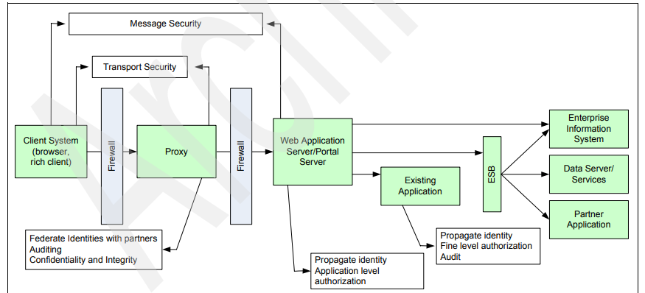
Typical logical deployment architecture for an SOA application

Slide 15
In most situations, there is a proxy (HTTP or Web services gateway) deployed in the demilitarized zone (DMZ) in front of either a Web application or portal server.
The Web application/portal server leverages existing applications/services either directly or through an ESB.
Clients can be users or service consumers, both internal or external. Similarly, existing applications/services can be either internal or external. In this type of a deployment, security is enforced at various points within the architecture.
The proxy can enforce confidentiality and integrity, identity validation, authentication, and auditing. The identity derived at the proxy might need to be propagated to the application server where the propagated identity needs to be accepted and additional security checks, such as authorization, can be enforced, as well as auditing this activity.
Further security enforcement can be performed by the other components within the architecture as well.

Slide 16
Two main observations
Security infrastructure integration challenge: Because each component is enforcing an aspect of security, there can be multiple identity and authentication systems, multiple authorization engines, and multiple audit logs.
In a typical environment, these security systems are not well integrated and therefore can be considered a challenge in an SOA environment.
Security management challenge: From a management perspective, there are multiple islands of administration specific to products and usually prone to error, inconsistency, and lack of coordination.
Management can be resource-centric, and policy management is isolated to a business unit, application, or product. This makes for a challenge in an SOA environment where consistent policies need to be enforced across multiple components of the architecture.
These observations need to be factored in (and addressed) when developing the SOA Security Reference Model.
So let us have a closer look at them in the following order:
-“Identity propagation, mapping, and provisioning”
- “Authorization”
- “Audit”
- “Data Protection”

Slide 17
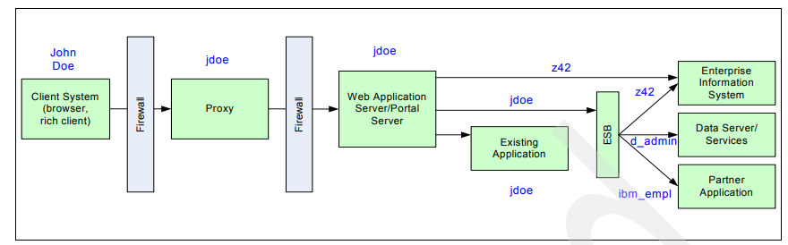
Identity propagation, mapping, and provisioning
Challenges faced: Example

Slide 18
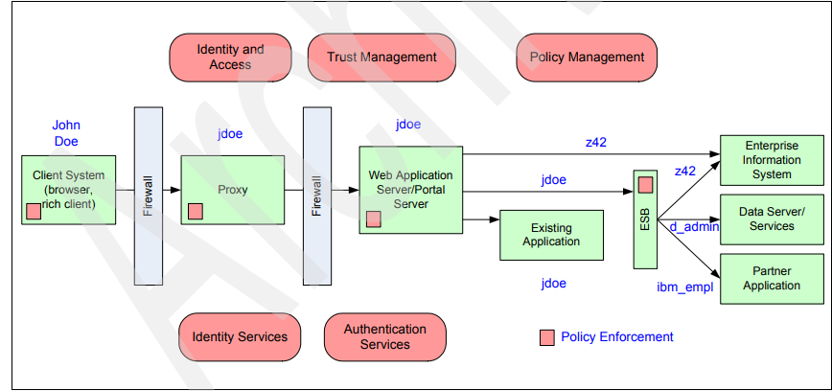
Addressing the requirements around identity propagation and mapping

Slide 19
In this example, user John Doe is authenticated at the proxy as jdoe. The proxy determines if the user is authorized to access the Web application server/portal server. If so, the request and identity are propagated to the Web application server/portal server. This identity, commonly termed an authenticated identity, is then used by the Web application server/portal server for its own authorization and auditing.
The Web application server/portal server then generates requests to either an Enterprise Information Server (EIS), an ESB, or an existing application: Enterprise Information Server (EIS): This is a back-end system (for example, CICS or IMS™) receiving requests directly from the Web application server/portal server. An identity mapping is required to transform jdoe into an identity suitable for the EIS (z42). There are two choices of identity mapping: – Map jdoe into John Doe’s identity on the EIS. This requires a one-to-one mapping of user identities. This case is suitable when the EIS needs to perform authorization or auditing using John Doe’s identity. – Map jdoe into an administrative or system identity on the EIS. This case is suitable when the EIS only requires a common administrative identity (perhaps the user’s role) for authorization and auditing. The EIS does not need to know who the user is.

Slide 22
Both cases introduce their own identity management concerns and might not adhere to some of the compliance requirements. Other than identity mapping, there is also an issue of identity token format. For example, jdoe might be represented as a Kerberos ticket whereas the z42 identity token might include a RACF® passticket. Hence, there are two challenges: identity mapping and identity token translation. Enterprise Service Bus (ESB): The ESB receives service requests. These requests propagate John Doe’s identity jdoe so no mapping is required at the creation of these requests. However, at the ESB, three identity mappings/identity format translations are required: – EIS: Same mapping as described above. – Data server/services: This is a back-end data system (for example, DB2® Database) receiving requests from the ESB. An identity mapping is required to map jdoe to the data server’s identity, in this case d_admin. In a similar way to the EIS, this server requires either a user’s identity or an administrative identity. It also requires the identity format to be altered into the correct representation. – Partner application: It is very likely that this application is situated within another organization. The request from the ESB needs to propagate the identity expected at the business partner, in this case, ibm_empl. In a similar way to the EIS and data server cases, this server requires either a user’s identity or an administrative identity. Existing Application: This application requires the same jdoe identity to be propagated and no identity mapping is required.

Slide 23
Elements of a solution
To address the requirements of identity propagation, mapping, and provisioning, an ideal solution needs to include both business and technical aspects. From a business view, we need: Trust Management: Trust is fundamental to managing risk and security. Managing trust relationships between systems/businesses and reflecting the relationship in business transactions, system deployments, and service policies is important. Identity and Access Management: Business aspects to deal with the management of identities both within an enterprise, as well as across enterprises. This also includes management of access policies to resources based on identity information and resource information.

Slide 24
From a technical view, we need: Identity and Authentication Services: A standards-based service to handle which user identity is passed, and how is it passed. For example, WS-Trust defines a mechanism for security token exchange to validate and issue credentials within different trust domains. Similarly, we need a standards-based framework for provisioning identities in a consistent way based on business policies. For example, WS-Provisioning and Service Provisioning Markup Language (SPML) provide a framework for managing the provisioning and allocation of identity information and system resources within and between organizations. Policy Management: A mechanism to create policies based on business drivers and influencing factors (such as trust and identity) and to distribute them in a consistent manner to all the relevant components within a logical deployment architecture. A policy infrastructure is important to keep track of policy life cycle management, adhere to governance and compliance requirements, and ensure the enforcement of correct policies.

Slide 25
Addressing the requirements around identity propagation and mapping

